Slide 1

Predicting Organic Customers
A Data-Driven Customer Profiling Approach
By: Kristina Grkovic
Notes:
Today, I'll be presenting insights on predicting organic product buyers, focusing on key customer segments and how we can use data to optimize marketing strategies.

Slide 2
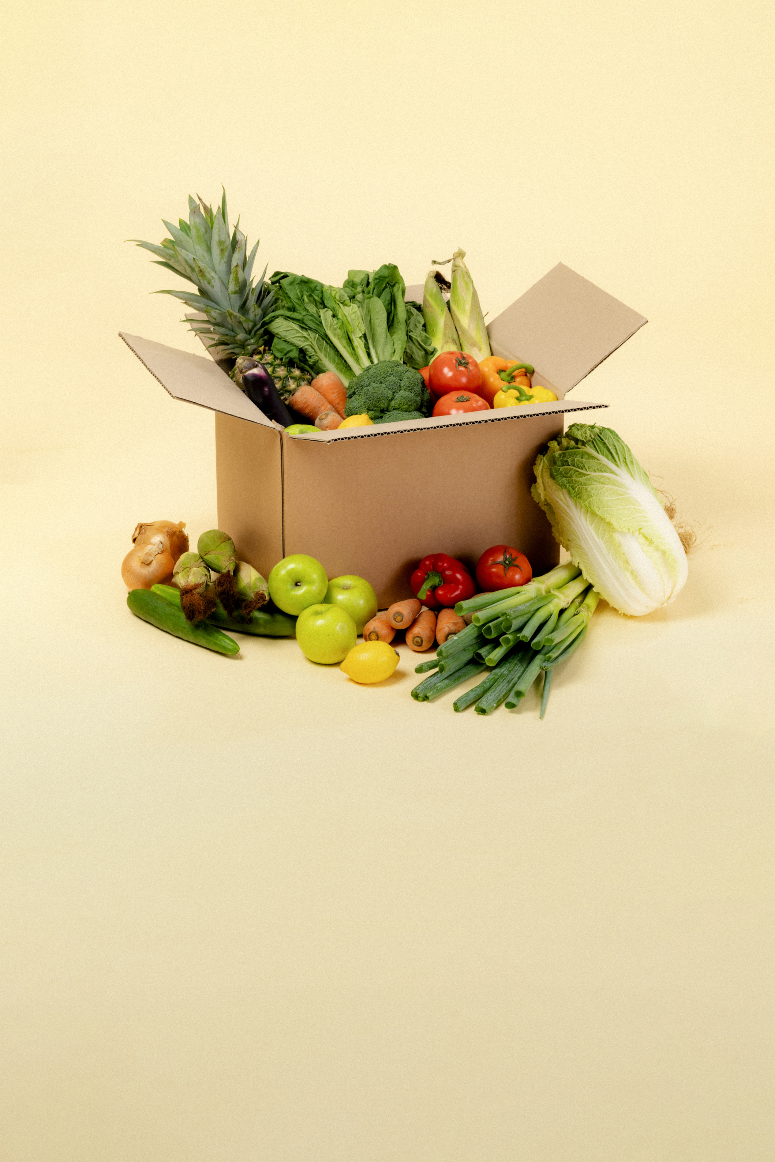
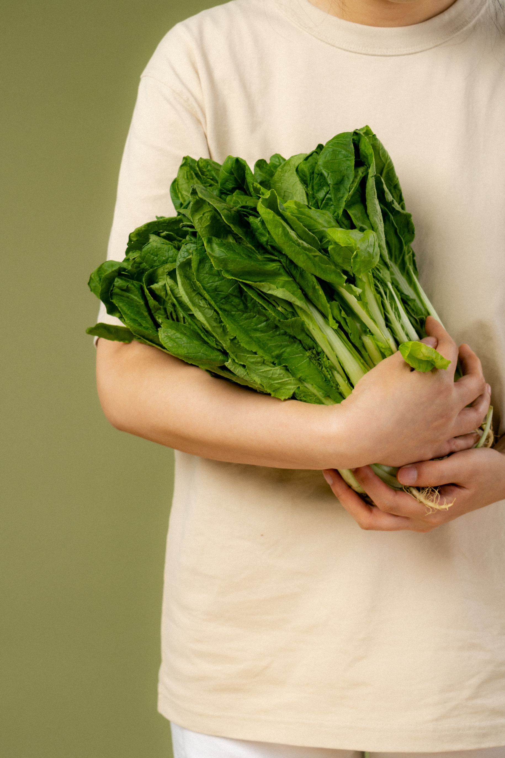
Table of Contents
Problem Overview
Initial Insights (Age, Loyalty Status)
Model Development and Comparison
Final Model
Organic Customer Profile
Recommendations
Key Takeaways
Technical Appendix
Notes:
We'll start with the problem overview, move into initial insights, then dive into model development and comparisons, followed by our final model selection, customer profiles, recommendations, key takeaways, and technical details.

Slide 3
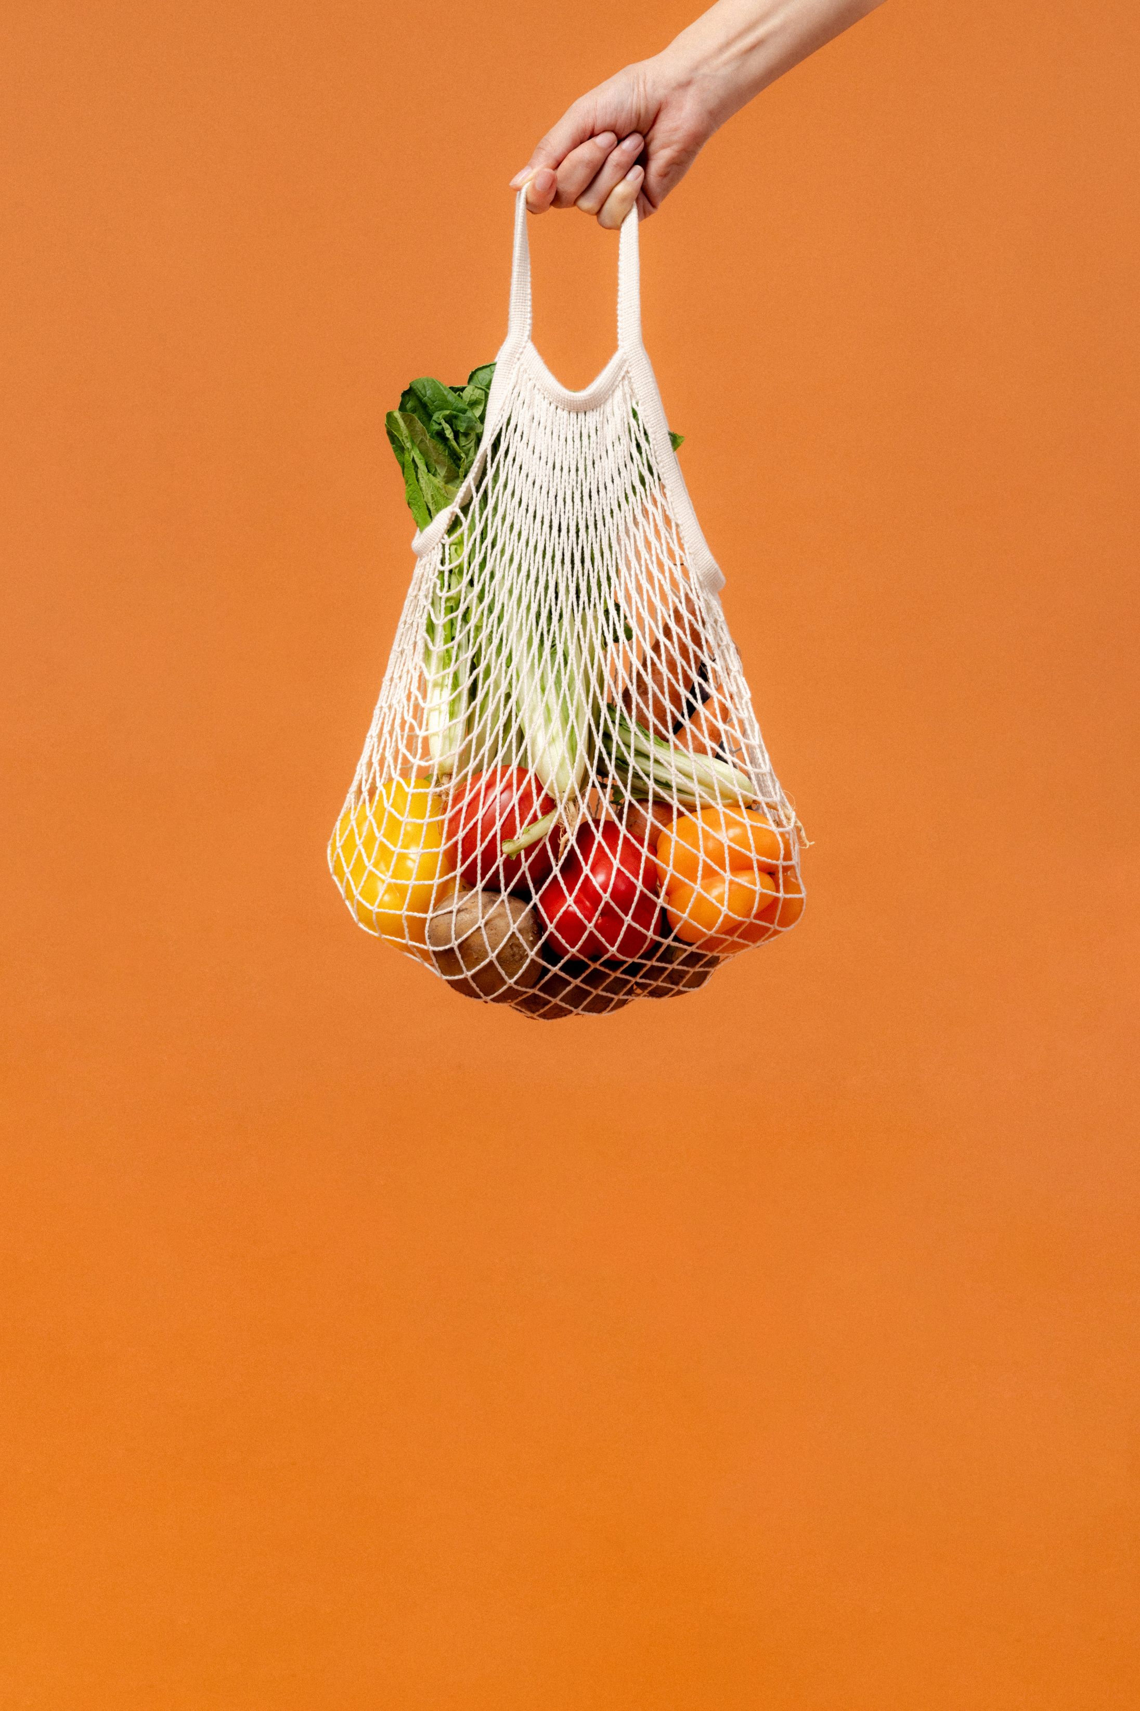
Introduction
The objective of this analysis is to identify customers most likely to purchase organic products
Key Questions:
Which customer segments are more likely to buy organic?
Do organic customers spend more?
How can insights be leveraged for marketing?
Notes:
The goal is to identify customers most likely to purchase organic products to enhance targeted marketing efforts and improve revenue.
We aim to understand who buys organic, whether organic customers spend more, and how we can leverage this insight.

Slide 4
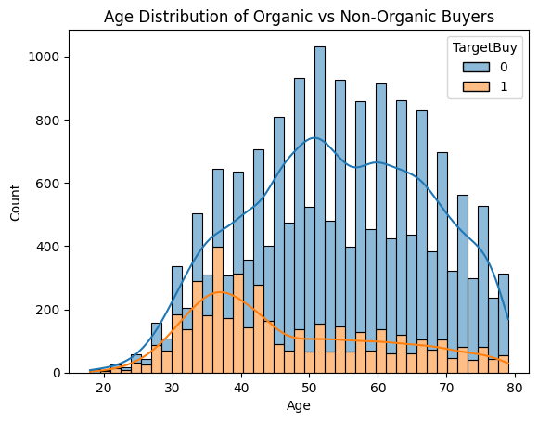
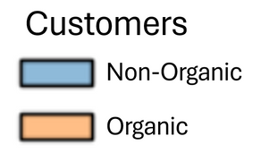
Initial Insights
Age Distribution
Customers aged 30 to 50 show the highest likelihood of purchasing organic products
Younger and older demographics have lower purchase rates
The distribution suggests a peak in organic purchases around the mid-40s age range
Notes:
Upon a first look and analysis of the data, we can see that customers aged 30-50 are the most likely to buy organic products, with the highest purchase rate occurring around the mid-40s.
Younger and older demographics show lower interest.

Slide 5
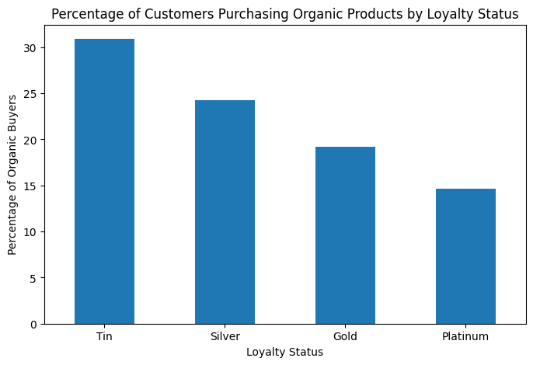

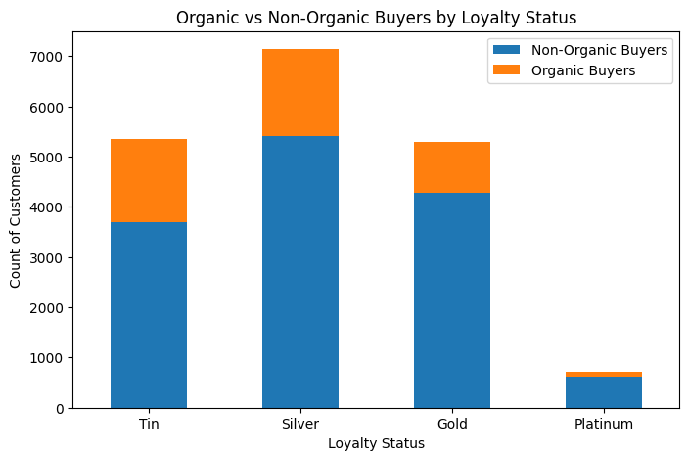
Loyalty Status
Tin - highest percentage of organic buyers (30%)
Silver - high proportion of organic buyers.
Gold - moderate proportion
Platinum - lowest organic adoption rate
Notes:
We found that Tin-tier customers have the highest percentage of organic buyers at 30%, followed by Silver-tier members.
Gold and Platinum members, despite their high spending capacity, have the lowest organic adoption rates.

Slide 6
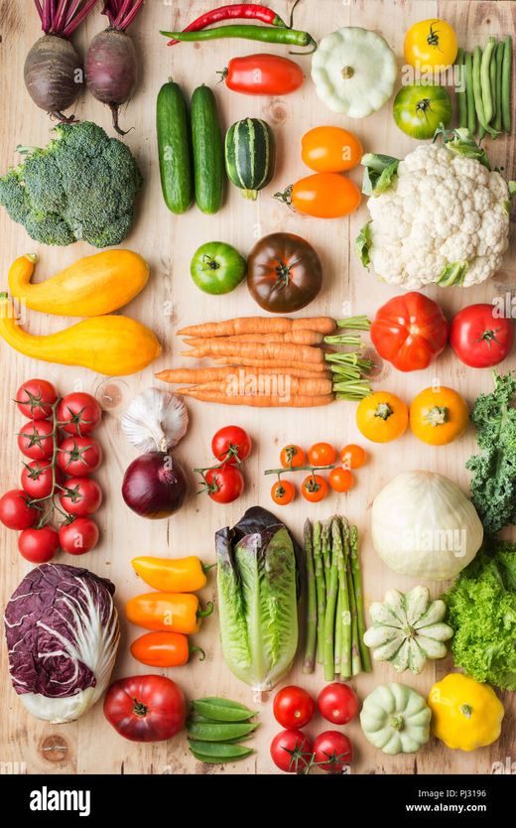
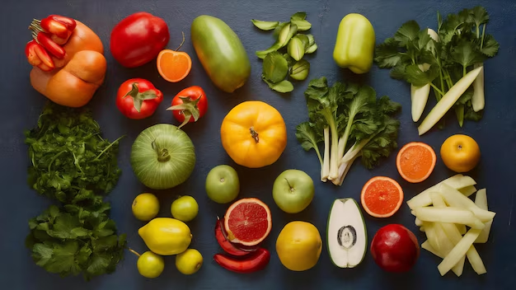
Model Development & Comparison
Method
Tested five different models to understand which one best predicts organic product buyers.
Improved some models by fine-tuning them for better results.
Focused on finding the right balance between identifying potential buyers and avoiding unnecessary marketing efforts.
Notes:
We tested five different models to find the best one for identifying organic buyers.
These models were improved through fine-tuning to ensure they accurately identify the right customers while minimizing mistakes.
We measured how well each model performed based on how accurately they predicted organic buyers and how effectively they identified potential customers without including too many who aren’t interested.

Slide 7
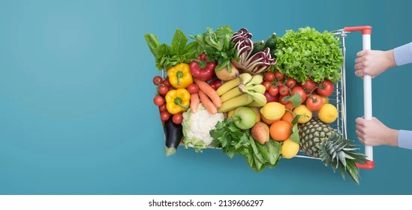

Final Model
Two final models were chosen because they predict who is most likely to purchase organic products with higher confidence.
Age
Customers aged 30-45 are the top buyers
Affluence
Higher-income customers prefer organics
Gender
Women are more likely to purchase organic
Loyalty Status
Silves & Tin shoppers buy organic
Notes:
After testing different methods, we chose two models that work best for predicting who is most likely to buy organic products.
These models help us find the right customers while reducing mistakes.
Key Insights:
Age: Customers aged 30-45 are the most likely to buy organic.
Affluence: Higher-income shoppers prefer organic products.
Gender: Women are more likely to purchase organic.
Loyalty Status: Silver and Tin loyalty members show the highest interest in organic products.
With these insights, we can focus our marketing efforts on the right people, ensuring that promotions and product offerings align with customer preferences.
This approach allows us to make smarter business decisions and boost organic sales effectively.

Slide 8


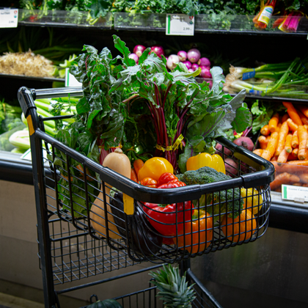
Organic Customer Profile
Healthy Hannah
Demographics
Female
30-45 years old
Silver Loyalty Status
Lower Index Residential Area
Spending Habits
Annual promotion spending ≥ $17,107
Consistently engaged with store promotions and loyalty benefits
Notes:
Meet Healthy Hannah, our typical organic product buyer. She’s 30-45 years old, part of the Silver loyalty program, and actively engages with store promotions.
Who is Healthy Hannah?
Hannah prioritizes a healthy lifestyle with organic products and seeks high-quality options while taking advantage of promotions and loyalty rewards. She spends over $17,000 annually on store promotions, showing strong interest and loyalty. She shops regularly and looks for high-quality organic products but also wants good value through promotions and loyalty rewards.
She frequently shops at urban and suburban supermarkets, prefers organic produce, dairy, and packaged health foods, and actively responds to personalized discounts and special offers.
Hannah engages with digital promotions, enjoys trying new organic products when offered compelling incentives, and is interested in sustainability and eco-friendly choices.
Understanding customers like Healthy Hannah helps us create better marketing strategies that align with their preferences—offering targeted promotions, eco-friendly options, and personalized experiences to drive sales and loyalty.
By focusing on customers like Healthy Hannah, we can increase organic sales and build long-term relationships.

Slide 9
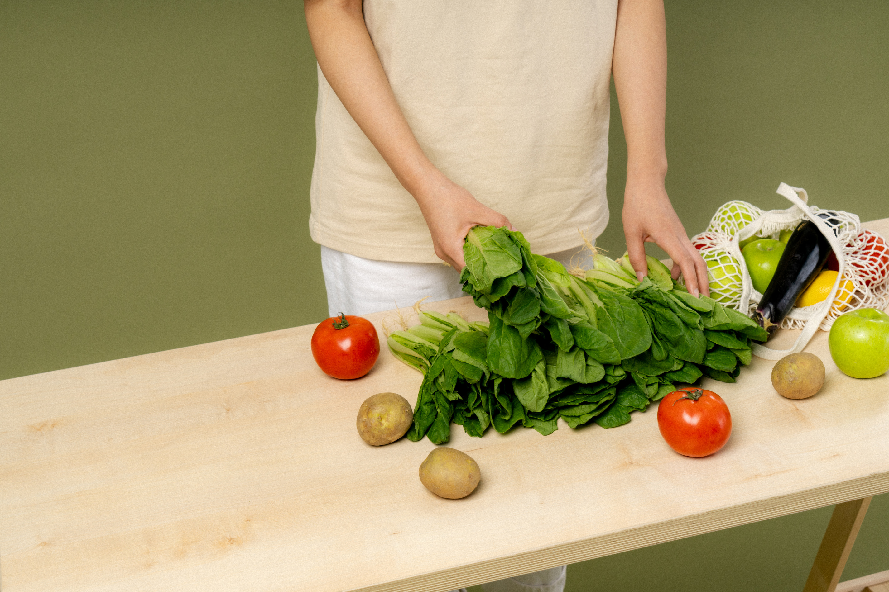
Recommendations
Targeted Marketing
Personalized offers for Silver-tier members
Age-based promotions (30-45 years)
Digital campaigns for affluent areas
Loyalty Program Enhancements
Exclusive organic discounts
Bonus points for repeat purchases
Tiered reward system
In-Store Optimization
Highlight organic sections
Sampling & education events
Product Bundling & Promotions
Bundled deals for organics
Seasonal campaigns
Notes:
Based on our findings, we recommend personalized marketing for Silver-tier members, exclusive discounts, and better in-store visibility to boost organic product sales.
These strategies will help maximize the return on investment in organic promotions.

Slide 10
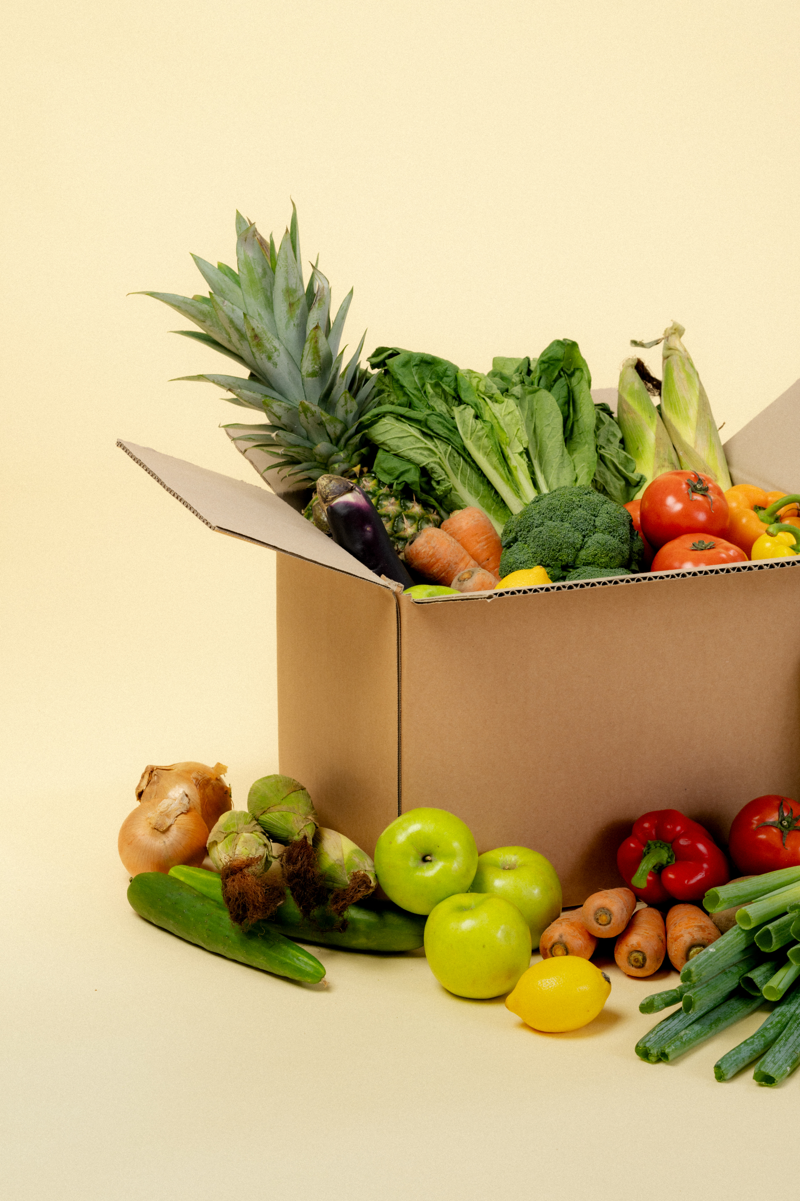
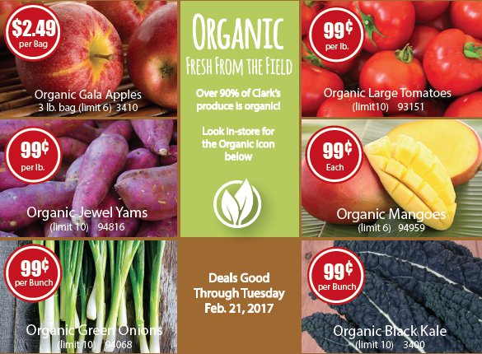
Key Takeaways
Who Buys Organics?
Female, 30-45 years, Silver-tier members
Higher affluence, engaged in promotions
Actionable Steps
Focus on targeted marketing
Optimize loyalty incentives
Improve in-store visibility
Notes:
Our key insights show that organic buyers are typically women aged 30-45 with higher affluence and Silver-tier status.
By focusing on targeted marketing and loyalty optimization, we can increase organic sales effectively.

Slide 11

Notes:
Thank you for your time.

Slide 12
Technical Appendix
Data Preparation
Handled missing values in DemGender by replacing NaN with "U" (unknown) due to 11% missing data.
Dropped remaining null values across all columns.
Removed irrelevant columns:
ID (not useful for modeling).
TargetAmt (high correlation of 0.913721 with TargetBuy).
Notes:
We handled missing values by filling gaps in gender data, removed irrelevant columns like ID and highly correlated features like DemGender.

Slide 13
Technical Appendix
Model Development
Split data into training (70%) and testing (30%) subsets and developed 5 models:
1. Decision Tree (Default)
Baseline model for comparison.
Threshold set to 0.23 for balanced tradeoff between precision and recall
2. Tuned Decision Tree
Grid search optimization for hyperparameter tuning.
3. Random Forest (Default)
Improved performance through assembling.
4. Tuned Random Forest
Parameter tuning to enhance predictive power.
5. Gradient Boosting (Final Model)
Chosen for best performance.
Notes:
We split the model into training and testing sets, with 30% test size.
We assessed models based on accuracy, precision, recall, F1 score, and AUC to ensure they can effectively identify organic buyers while minimizing false positives.
Emphasis was placed on the F1 score (the tradeoff between precision and recall) because we are trying to predict a minority variable.

Slide 14
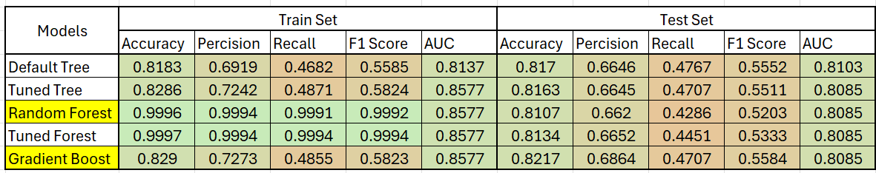
Technical Appendix
Model Evaluation
Metrics computed for train and test sets across all models:
Accuracy
Precision
Recall
F1 Score
AUC-ROC
After evaluations Tuned Random Forest and Gradient Boosting models were selected for their superior balance between precision and recall, ensuring optimal identification of organic product buyers while minimizing false positives.
Tuned Random Forest:
High precision of 0.6652 and a respectable recall of 0.4451 on the test set.
Gradient Boosting:
Achieved the best balance of precision (0.6864) and recall (0.4707), resulting in the highest F1 Score (0.5584) on the test set.
Less prone to overfitting compared to the Random Forest.
By leveraging both models, the business can benefit from the interpretability of Random Forest for actionable insights and the predictive power of Gradient Boosting for targeted marketing efforts.
Notes:
I chose both the Tuned Random Forest and Gradient Boosting models because they offer different strengths.
Tuned Random Forest:
Helps us understand key factors driving organic purchases with clear visual insights.
Easier to interpret and create customer profiles.
Gradient Boosting:
Provides the most accurate predictions.
Best for identifying potential buyers with confidence.
Random Forest helps explain ‘why’ customers buy, while Gradient Boosting ensures we target them accurately.
While Gradient Boosting performs best, the Random Forest’s interpretability makes it valuable for understanding customer behavior.
This combined approach balances accuracy with actionable insights to optimize marketing strategies.

Slide 15
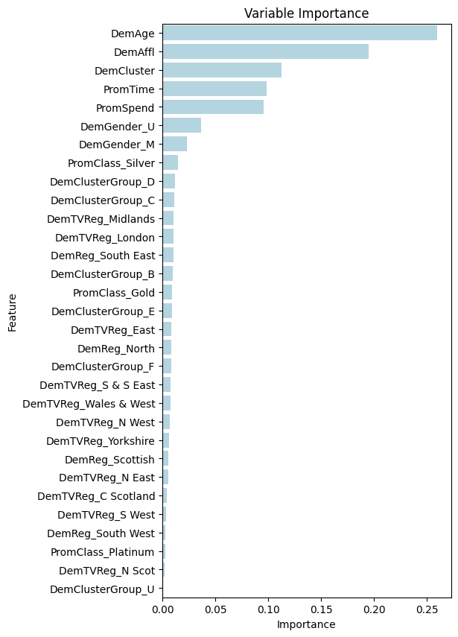
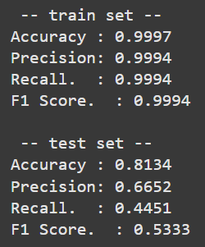
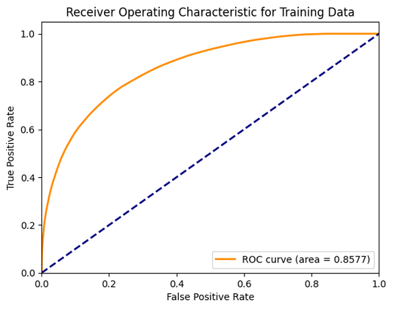
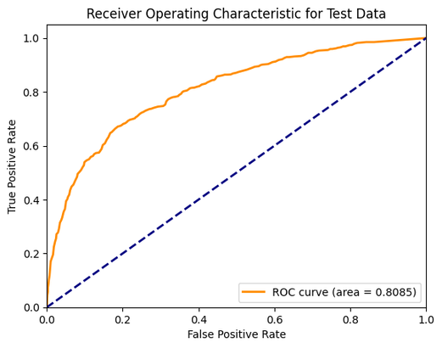
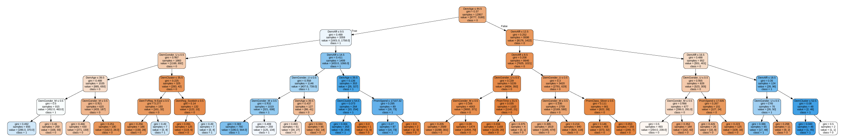
Technical Appendix
Final Model: Tuned Random Forest
Notes:
Here is the what the final model looked like for the Tuned Random Forest.

Slide 16
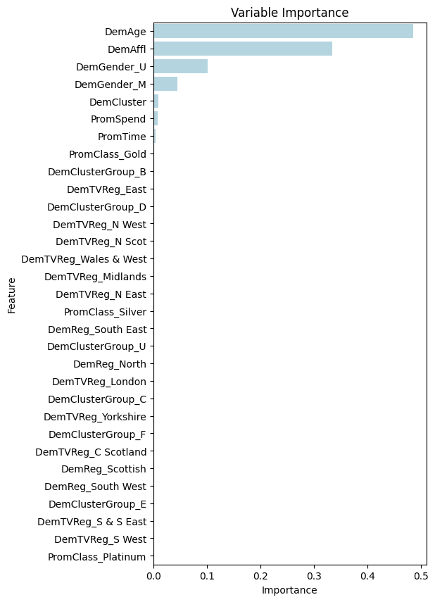
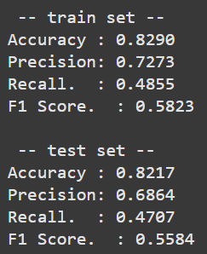
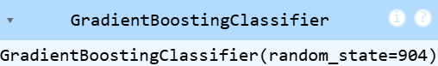
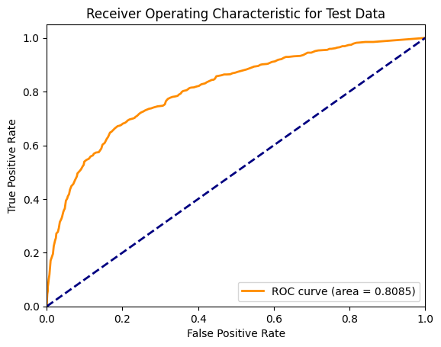
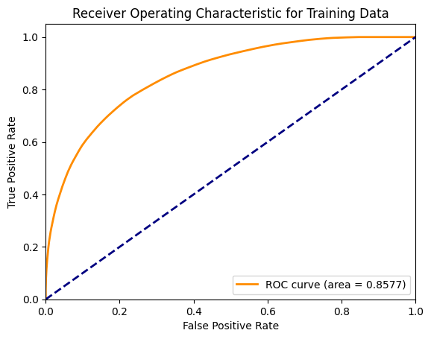
Technical Appendix
Final Model: Gradient Boosting
Notes:
Here is the what the final model looked like for Gradient Boosting.

